Slide 1

ATAX Problem Optimization
Assignment 1 – Team 5
Davide Buchignani – Francesco Caligiuri - Luca Di Leo – Salvatore Di Lorenzo

Slide 2
ATAX
The process of ATAX involves the multiplication of the matrix A, its transpose, and the vector x. This operation is fundamental in linear algebra for various computational tasks.
y = A^{T} A x

Slide 3
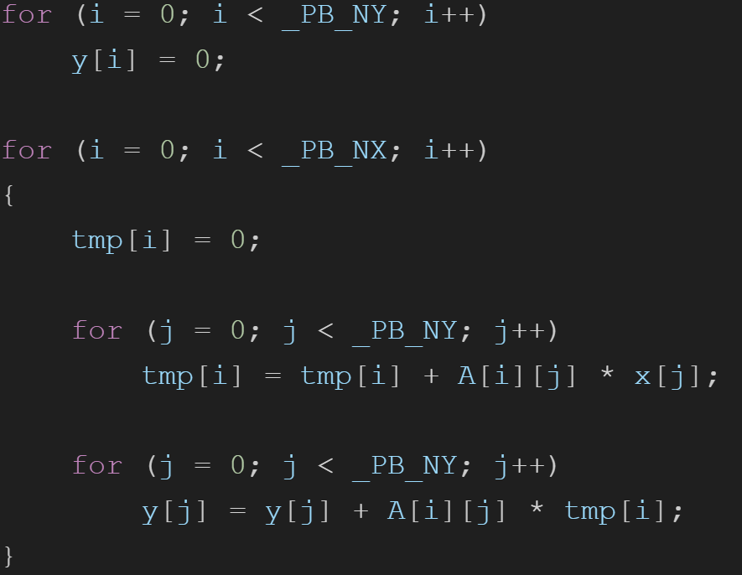
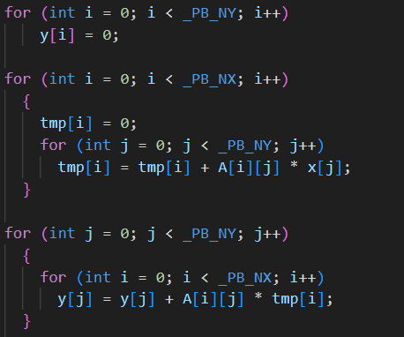
Code
Initialization of solution vector y
Computation of tmp = A ⋅ x
Computation of y = A^{T} ⋅ tmp

Slide 4
We tried to implement:
Parallel For
Parallel For + Reduction
Parallel For + Collapse
Accelerator Model
Task

Slide 5
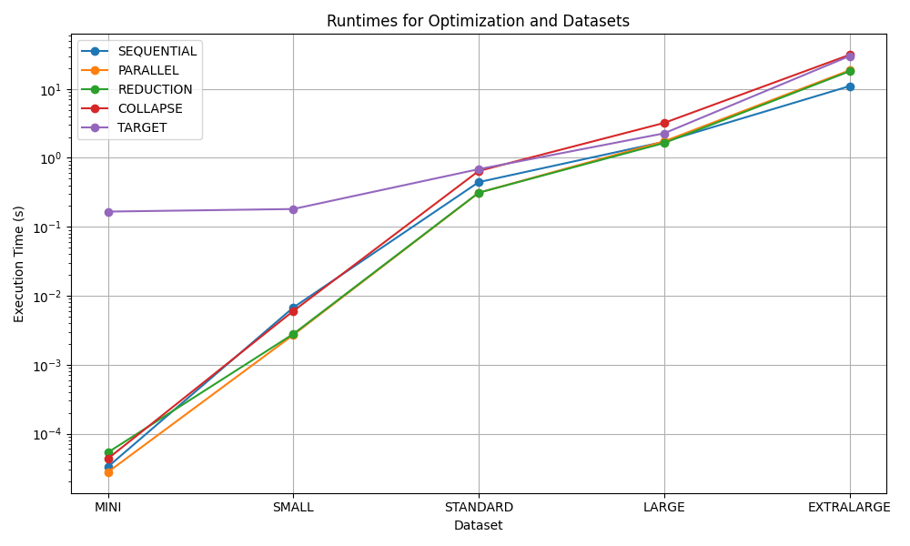
RESULTS COMPARISON

Slide 6
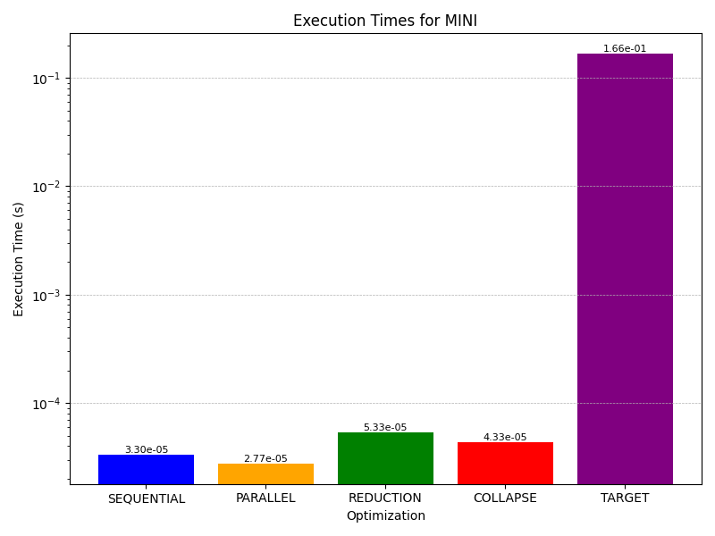
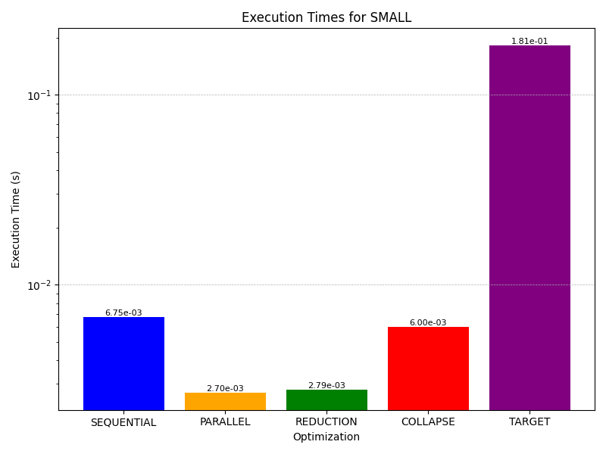

Slide 7
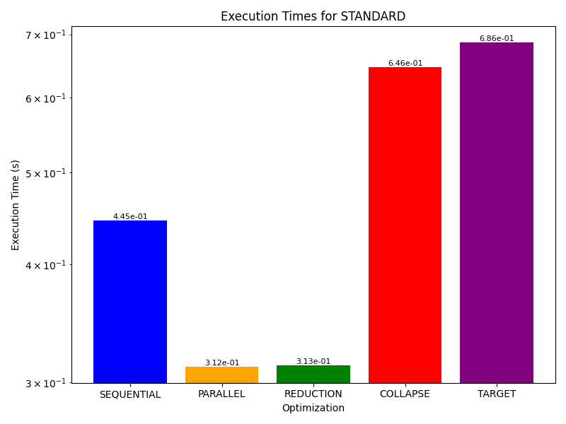
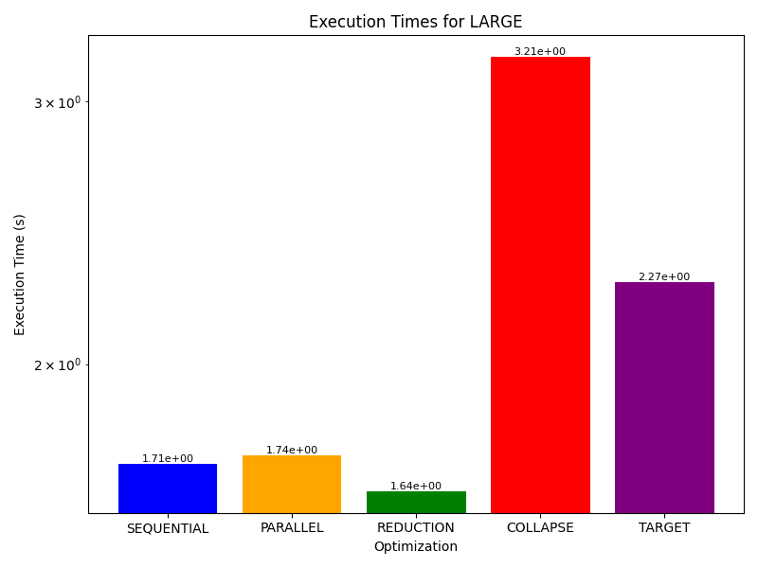

Slide 8
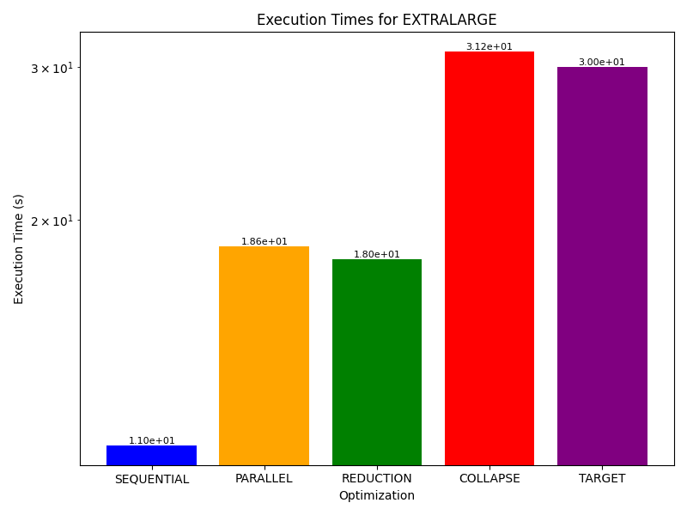


Slide 9
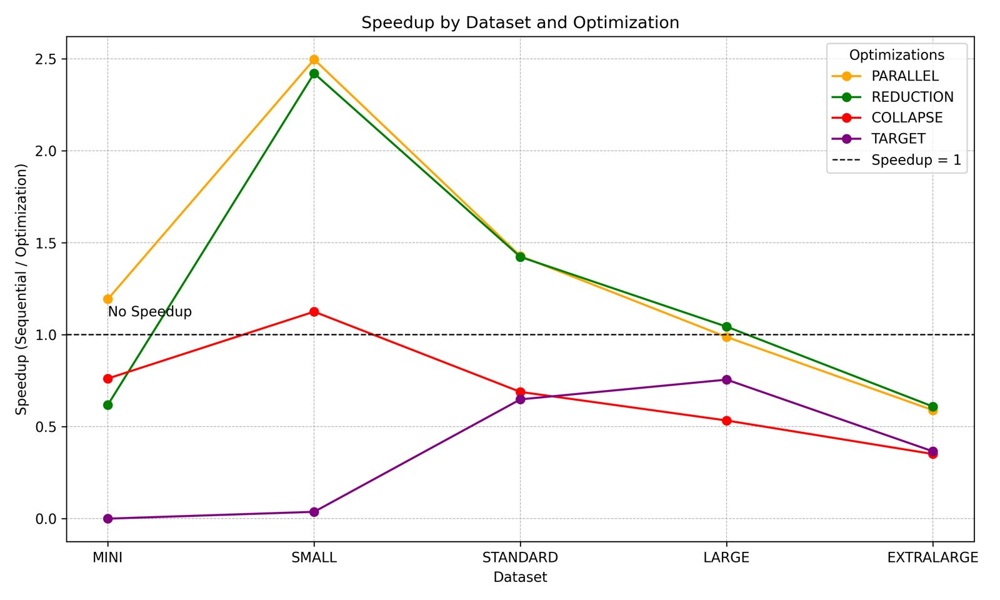
ACHIEVED SPEEDUP

Slide 10
Conclusions
Parallel For + Collapse
Useful on smaller loads of data
Accelerator Model
Overhead on small datasets, performs better with large loads
Task
Not effective due to the nature of atax

